Slide 1
Speech-Language Impairment Definitions, Eligibility, & Strategies
Created by

Slide 2
ISBE disability area definition:
Speech or Language Impairment
means a communication disorder, such as stuttering, impaired articulation, a language impairment, or a voice impairment, that adversely affects a child's educational performance.
Resources:
Illinois Speech-Language-Hearing Association
www.ishail.org
American Speech-Language-Hearing Association
www.asha.org

Slide 3
Speech-Language Pathology Services encompass such activities as:
Screening, diagnosis and appraisal of specific speech and language impairments;
Identification of children with speech and/or language impairments;
Referral and follow-up for medical or other professional attention necessary for the habilitation of speech and language impairments;
Planning and developing interventions and programs for children or youth with speech and language impairments;
Provisions of services for the habilitation and prevention of speech and language impairments; and
Counseling and guidance of parents, children, and teachers regarding speech and language impairments.
(www.isbe.org)

Slide 4
Types of Speech-Language Impairments:
Speech Sound Production
Receptive Language (listening)
Expressive Language (speaking)
Pragmatic Language (social)
Fluency (stuttering)
Voice

Slide 5
Speech Sound Production Disorder defined:
The student is unable to produce sounds correctly in conversational speech. The impairment is typically characterized by the omission, distortion, substitution, addition and/or inaccurate sequencing of speech sounds. Errors are not related to cultural or dialectal differences.

Slide 6
A student is not eligible for special education and related services in the area of speech and language impairment when:
Sound errors are age appropriate
Sound errors are due to unfamiliarity of the English language, dialectal differences, temporary physical disabilities or environmental, cultural, or economic factors.
Sound errors do not affect the student’s ability to communicate in the school learning and/or social situations.
www.nsseo.org, speech-language criteria,
Team Input Forms and Articulation Profile

Slide 7
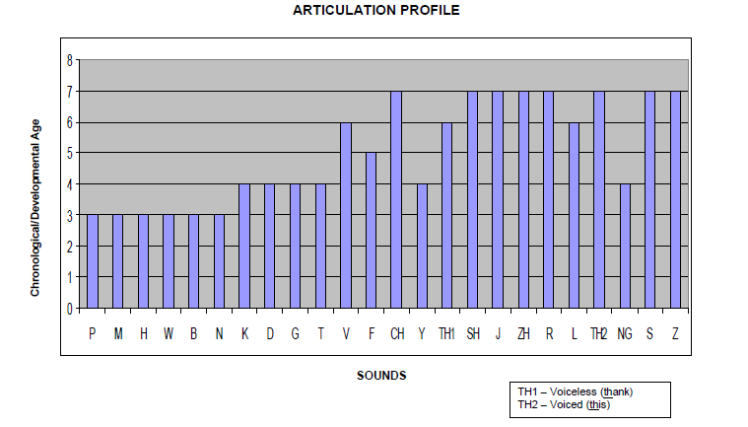
www.nsseo.org, speech-language criteria

Slide 8
Speech Sound Production skills are aligned with Common Core State Standards: SL.1,4,6 and College and Career Readiness Anchor Standards: SL.1,4,6. (www.nsseo.org, speech-language criteria)
1. Is this student difficult to understand? If most of the time, check appropriate description:
a. Occasionally (25% of the time)
b. Often (50% of the time)
c. Most of the time (75% of the time)
2. Does the child make errors in writing (spelling) he/she does in speaking (ex. wabbit for rabbit)?
3. Does the student appear frustrated when speaking because of his/her articulation?
4. Does the student appear to avoid speaking because of his/her articulation?
5. Are there obvious articulation errors when the student reads orally?
6. Have others reported concerns about this child’s speech?
7. Does the student’s articulation seem to limit social interactions?
8. Does the student appear to be aware of his/her articulation?
9. The student is unable to self correct his/her sound errors?
10. Does the student’s speech call attention to itself and distract you from the content of the message?
Do you have any additional observations?

Slide 9
Speech strategies for the classroom:
Increase awareness of speech sounds through discrimination (“stop” vs “top”)
Model the accurate speech sound production to facilitate imitation.
Use visual cues (gesture, picture, text)
Compensate by slowing down, hitting sounds, pausing between phrases, and looking at the listener.
Provide opportunities for practice during the school day in routine activities.

Slide 10
Language Disorders defined:
as impaired comprehension and/or use of spoken, written and/or other symbol systems. The disorder may involve (1) the form of language (i.e. grammar), (2) the content of language (i.e. vocabulary), and/or (3) the function of language in communication (i.e. social) in any combination.

Slide 11
A student is not eligible for special education and related services in the area of speech and language impairment when:
Language differences are primarily due to environmental, cultural, or economic factors including non-standard English and regional dialect
Language performance does not interfere with the student’s ability to benefit from education.
www.nsseo.org, speech-language criteria, Team Input Forms

Slide 12
K-2 Oral Language: Listening & Speaking
Rating scale: 5 for mastery, 4 for developing, 3 for emerging, 2 for rarely, 1 for absence. As compared to typically developing peers, the student is able to:
5 4 3 2 1
Understand words and their meanings. (CCSS: L4,5,6 / RL4)
Demonstrate knowledge of basic concepts (time, space, number). (CCSS: L4,5,6 / RL4)
Demonstrate adequate expressive vocabulary. (CCS: L6))
Use specific vocabulary (rather than “stuff”, “like”, “thing”, “you know”, “I mean”). (CCSS: L6)
Name common items without substitutions/talking around them. (CCSS: L6)
Express self effectively using organized, sequential thoughts (w/o excessive revisions/repetitions). (CCSS: SL6)
Comprehend and respond to basic WH questions (who, what, when, where, how, why). (CCSS: SL3 / RL1,4)
Listen to a story and demonstrate comprehension. (CCSS: SL2)
www.nsseo.org, speech-language criteria

Slide 13
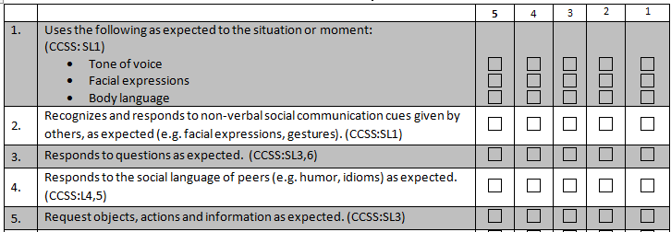
K-5 Social Language Team Input
Rating scale: 5 for mastery, 4 for developing, 3 for emerging, 2 for rarely, 1 for absence. As compared to typically developing peers, the student is able to:
www.nsseo.org, speech-language criteria

Slide 14
Comprehension strategies for the classroom:
Get the student’s attention before speaking
Provide ‘wait time’ for student to process the direction or question.
Present the spoken directions with visual support (gesture, picture, text).
Encourage students to ask questions when they don’t understand.
Check comprehension with a question.

Slide 15
Strategies for the classroom to support expression:
Repeat the message in error to the student to facilitate self-monitoring and correction. (Easier to monitor on others)
Expand upon the student’s spoken message. (i.e. The man entered the room. “The tall man entered the dark room.”)
Restate the student’s message with accuracy. (i.e. It falled on the floor. “It fell on the floor.”)
Provide a carrier phrase for sentence completion. (i.e. A plateau is a …)
Utilize graphic organizers to support narrative and oral reports (see Holt Interactive Graphic Organizers).

Slide 16
Strategies for the classroom to support social language:
Talk about hidden social rules (i.e. When someone pauses, it is your turn to talk.)
Role play new or challenging social situations
Take advantage of teachable moments (i.e. greeting others upon entering the classroom)
Provide opportunities for the student to state what he/she thinks and/or feels when…
Discuss the perspective of others (i.e. “How does your friend feel when you…?”)
www.socialthinking.com

Slide 17
A Fluency (stuttering) Disorder defined:
as the abnormal flow of verbal expression. It is characterized by impaired rate and rhythm of connected speech and may be accompanied by struggle behavior.
Consideration must be given to the student’s chronological age and perception of the problem by the student and parents, the contextual situations in which the student functions and the overall impact on educational performance.

Slide 18
A student is not eligible for special education and related services in the area of speech and language impairment when dysfluencies:
Are part of normal speech development.
Do not cause the speaker to modify behavior.
Do not interfere with the student’s ability to benefit from education.
www.nsseo.org, speech-language criteria

Slide 19
www.nsseo.org, speech-language criteria

Slide 20
Strategies for the classroom to increase fluency:
Try to model ‘slow and relaxed’ speech when talking to the student.
Give undivided attention when listening to the student.
Model ‘pausing & thinking’ before sharing thoughts.
Take turns talking & listening. Do not interrupt the student.
Reassure the student (i.e. “ I know it is hard to talk sometimes.”)

Slide 21
A Voice Disorder defined:
As any deviation in pitch, loudness, quality, or other attribute which consistently interferes with communication; draws unfavorable attention; adversely affects the speaker or the listener; or is inappropriate to the age, sex, or culture of the individual. Voice quality can be affected by either organic or functional factors.
Consideration must be given to age, sex, environment, and perception of the problem by the student, parents, speech language pathologist, and other school personnel or medical specialists.

Slide 22
A student is not eligible for special education and related services in the area of speech and language impairment when dysfluencies:
Are the result of temporary physical factors such as allergies, colds, abnormal tonsils or adenoids, short term vocal abuse or misuse.
Are the result of regional, dialectic or cultural differences.
Do not interfere with the student’s ability to benefit from education.
www.nsseo.org, speech-language criteria

Slide 23
For Additional Information:
Contact your building and/or program
speech-language pathologist.

