Slide 1


Transition Care for Individuals with Developmental Disabilities
Kruti Acharya, MD
Director, Illinois LEND
University of Illinois at Chicago
Department of Disability and Human Development, Medicine and Pediatrics
acharyak@uic.edu

Slide 2
Overview
Review definitions and scope of problem
Review standard of care for health care transition
Describe practical tools and strategies for health care transition

Slide 3
What is Health Care Transition?
The purposeful, planned movement of adolescents and young adults- with or without chronic physical and medical conditions- from a child-centered model to an adult-oriented health care system
AAP Clinical Report, 2011

Slide 4
Who needs to transition?
All children transition
Individuals with special health care needs (SHCN) face unique challenges
  “[t]hose who have or are at increased risk for a chronic physical, developmental, behavioral, or emotional condition and who also require health and related services of a type or amount beyond that required by children generally.”
  Includes individuals with Developmental Delay, Intellectual disability, Autism
Maternal Child Health Bureau

Slide 5
Why is this important?
Children with SHCN are surviving to adulthood
>500,000 youth with SHCN transition to adulthood every year
  Need coordinated support for successful transition
  Currently many transition with minimal systematic support
Reiss J and Gibson R. Health Care Transition: Destinations Unknown. Pediatrics. 2002
Notes:
90% CYSHCN survey
n estimated 4.5 million or 18.4% of US youth ages 12 to 18 have a special health
care need, a
More than a third of YSHCN have an emotional, behavioral, or developmen- tal condition, and more than a quarter experience a persistent and significant impact on activities as a result of their condition.
McManus et al, 2013, Current Status of Transition Preparation Among Youth With Special Needs in the United States
Pediatrics
Assoc eith meeting core transiton outcome: female gender, non-Hispanic white race, speaking English in the home, and having a family income $400% of the federal poverty level (FPL). In addition, certain health and health care characteristics positively affect transition preparation. These include having a special health care
PEDIATRICS Volume 131, Number 6, June 2013
1093
Downloaded from by guest on March 15, 2017
need with no impact on activities; hav- ing a condition other than an emo- tional, behavioral, or developmental condition; receiving care within a medi- cal home; and having insurance cover- age.
into adulthood

Slide 6
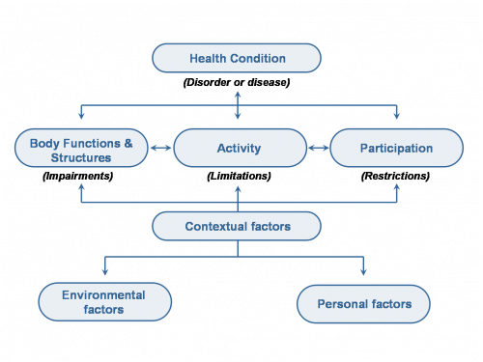
ICF model
World Health Organization
Notes:
6
International classification of functioning. There are 3 levels of functioning.
Body structures- anatomical parts of body such as organs and limbs. Body function- physiological functions of body systems including psychological such as remembering and thinking. Activity- tasks done by people. Learning, moving, walking, washing clothes, performing self-care, reading. Participation- activities in the community, involvement in a life siutation- relationships, education, group therapy, work, recreation. Loss of functioing at each level has a different term. Loss at body level is impairment (loss or organ structure of function). Activity limitation- restriction or difficulty performing an activity. Participation restriction- restriction in performing roles typical of peers. Disability can occur at any of these levels. Contextual can be facilitators or barriers. Environmental factors include social attitudes, architectural characteristics, legal and social structures, as well as climate, terrain. Personal = gender, age, coping styles, social background, education, profession, past and current experience, overall behaviour pattern, character and other factors that influence how disability is experienced by the individual.

Slide 7
Transition
Health Care
Vocation
Housing
Community
Education
Notes:
Health care transition, proivders play a role in larger process

Slide 8
AAP, AAFP & ACP
Consensus statement (2002)
Ensure that all young people who have special health-care needs have an identified health-care professional who attends to the unique challenges of transition and assumes responsibility for current health care, care coordination, and future health-care planning.
Identify core knowledge and skills required to provide developmentally appropriate health-care transition services to young people who have special health-care needs and make them part of training requirements for residents and physicians.
Prepare and maintain an up-to-date medical summary that is portable and accessible.
Create a written health-care transition plan by age 14 with the young person an family which should contain what services needed, who will provide them, how they will be financed.
Apply the same guidelines for primary and preventive care for all adolescents and young adults.
Ensure affordable, continuous health insurance coverage for all young people who have special health-care needs throughout adolescence and adulthood

Slide 9
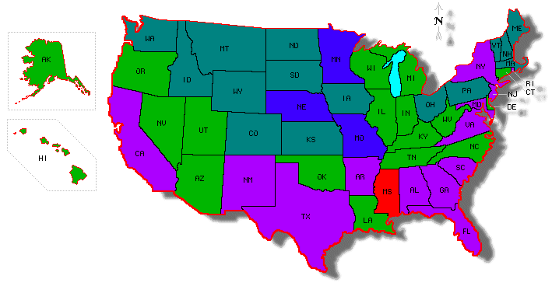
How are we doing?
● 1.5 SD above the mean
● 0.5-1.5 SD above the mean
● 0.5 SD above -0.5 SD below the mean
● 0.5-1.5 SD below the mean
● >1.5 SD below the mean
Rogers K 2010, http://www.gottransition.org/UploadedFiles/Files/GT_report_rev2.pdf
Notes:
National mean: 42.6%● More than 1.5 standard deviations (SD) above the mean ● Between 0.5 and 1.5 SD above the mean ● Between 0.5 SD above and 0.5 SD below the mean ● Between 0.5 and 1.5 SD below the mean● More than 1.5 SD below the mean
State performance on the Transition Performance Measure is assessed via parental report on several component questions in the National Survey of Children with Special Health Care Needs and is defined as the proportion of adolescents receiving the support necessary to transition successfully to adult life, health care, and work.
Page
Approximately 40% of youth with SHCN receive the services necessary to make transitions to adult health care, work, and independence¹
¹ McManus P and Rogers K., 2011
² Shattuck P et al. Pediatrics, 2012

Slide 10
Survey of Adult Transition and Health
N=1865 Adults
55% reported that their physicians had discussed how their needs would change with age
53% reported that their physicians had discussed how to obtain health insurance as an adults
62% reported having participated in a transition plan in school.
Only 24% reported receiving all 3 transition counseling services.
Sawicki GS et al., Pediatrics. 2011.
Notes:
Receipt of Health Care Transition Counseling in the National Survey of Adult Transition and HealthGregory S. Sawicki, Ruth Whitworth, Laura Gunn, Ryan Butterfield, Katryne Lukens-Bull, and David WoodPediatrics 2011; 128:e521-

Slide 11
Transition Care: Disparities
National Survey of SHCN: Percentage achieving Transition Outcomes (2005)
Non-Hispanic White | 47.6%
Non-Hispanic Black | 28.7%
Hispanic | 26.3%
Lotstein DS, Kuo AA, Strickland B and Tait F. Pediatrics 2010
Notes:
being Hispanic compared with non-Hispanic white decreased the odds of receiving HCT services by 71% for youth with ASD (OR: 0.29; 95% CI: 0.10, 0.86).
Insurance
Low income communities resources for community involvemnet and participation
Matern Child Health J. 2012 May;16(4):824-33. doi: 10.1007/s10995-011-0785-x.Can the Medical Home eliminate racial and ethnic disparities for transition services among Youth with Special Health Care Needs?Richmond NE1, Tran T, Berry S.

Slide 12
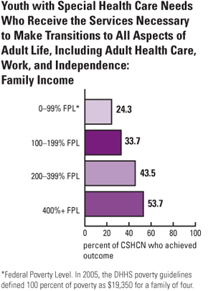
The National Survey of Children with Special Health Care Needs Chartbook 2005–2006. Rockville, Maryland: U.S. Department of Health and Human Services, 2008.
Notes:
. Children living in poverty were only half as likely as high-income children to receive adequate transition services (24 percent versus 54 percent).

Slide 13

“After nearly a decade of effort, widespread implementation of health transition supports as a basic standard of high quality care has not been realized. To date, only limited progress can be documented in the achievement of the consensus statement’s 6 critical steps.”
  AAP, AAFP, ACP, 2011

Slide 14

Provider Level Barriers
Pediatrician
  Not enough time
  Not reimbursed
  No where to go
Internist
  Not enough time
  Not reimbursed
  Inadequate training
  Limited subspecialists
  Accessibility
Notes:
Most pediatricians do not initiate transition planning in adolescents
There is often lack of time and reimbursement for transition planning
There is often anxiety on the part of the pediatrician
Limited availability of adult providers who are comfortable caring for young adults with complex chronic conditions
Internists may lack understanding of the social services and benefits for those with special health care needs and may lack social worker support
Reasons cited: lack of time, training, adequate payment
There may be structural barrier in the internist office that prevents the patients from being seen
No wheel chair scale, patient rooms which are not wheel chair acceptable

Slide 15
Patient-Family Level Barriers
Young adults with SHCN may not have self-management or self-advocacy skills
Family unaware of need to transition
Different culture in pediatrics vs. internal medicine
  Family-centered vs patient-centered
  Case management and SW support
  Change in physician expectations and patient responsibility
  Privacy and decision-making

Slide 16
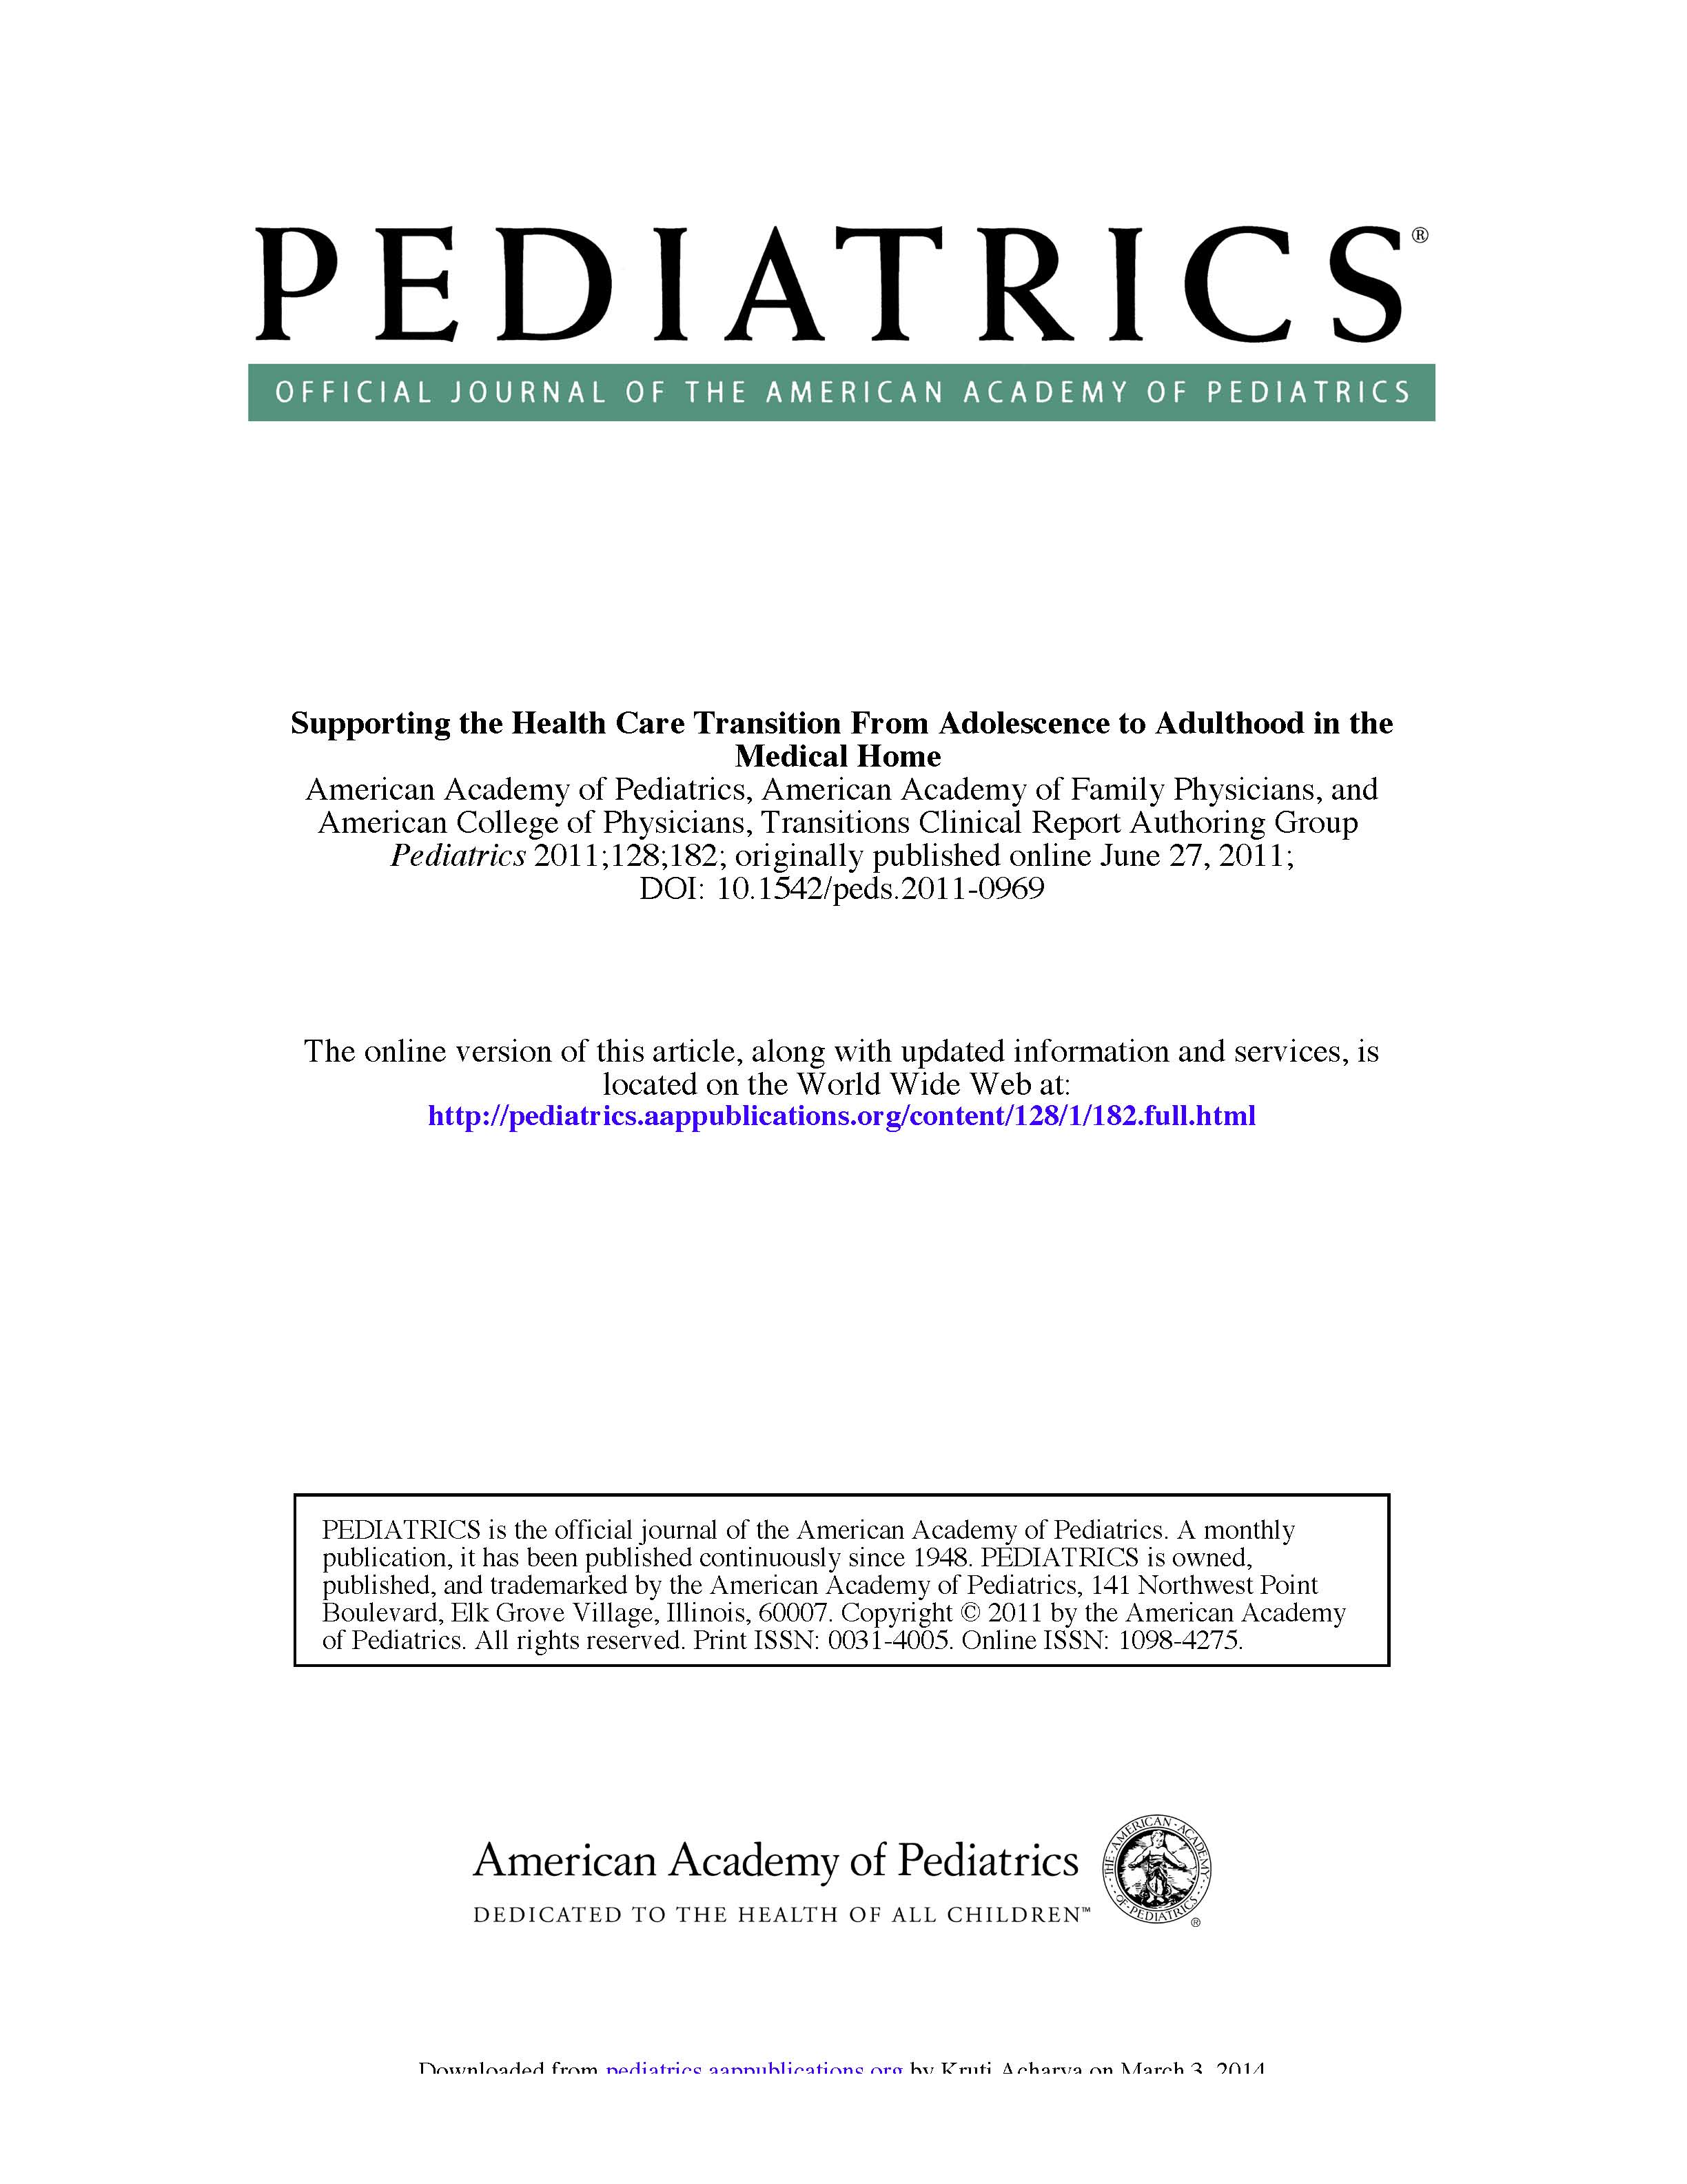

Slide 17
Transition timeline
12
14
Make youth and family aware of transition policy
16
18
18-22
Initiate health care transition planning
Prepare youth and parents for adult model of care and discuss transfer
Transition to adult model of care
Integrate young adults into adult care
23-26
Transfer care to adult medical home and/or specialists with transfer package

Slide 18
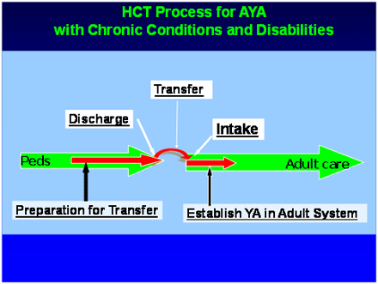
6 Core Elements of Transition
Transition Policy
Transition tracking and monitoring
Transition readiness
Transition planning
Transfer of Care
Transfer Completion
gottransition.org; http://www.hctransitions.org/?m=201002

Slide 19
Office-level systems
Develop an office transition policy which includes
  The expected age of patient transfer to the adult model of healthcare
  Outline roles of patient, family/caregivers, medical home provider
  Family and patient input

Slide 20
Office-level systems
Create patient registries for tracking and monitoring
  Highlight population that needs dedicated care
  Streamline education
  Streamline implementation of new initiatives
Appointment scheduling
  Have a separate visit for transition
  Batch transition visits together
  Group education sessions

Slide 21
Getting ready for transition
Process starts at 12
Educate family about office transition policy
  Process should be “normalized”
Assess youth and family transition readiness

Slide 22
Transition Plan
Dynamic and longitudinal
Goal-oriented
Should include chronic condition management and preventative care
By age 14, a formal written plan and checklist should be part of the medical record

Slide 23
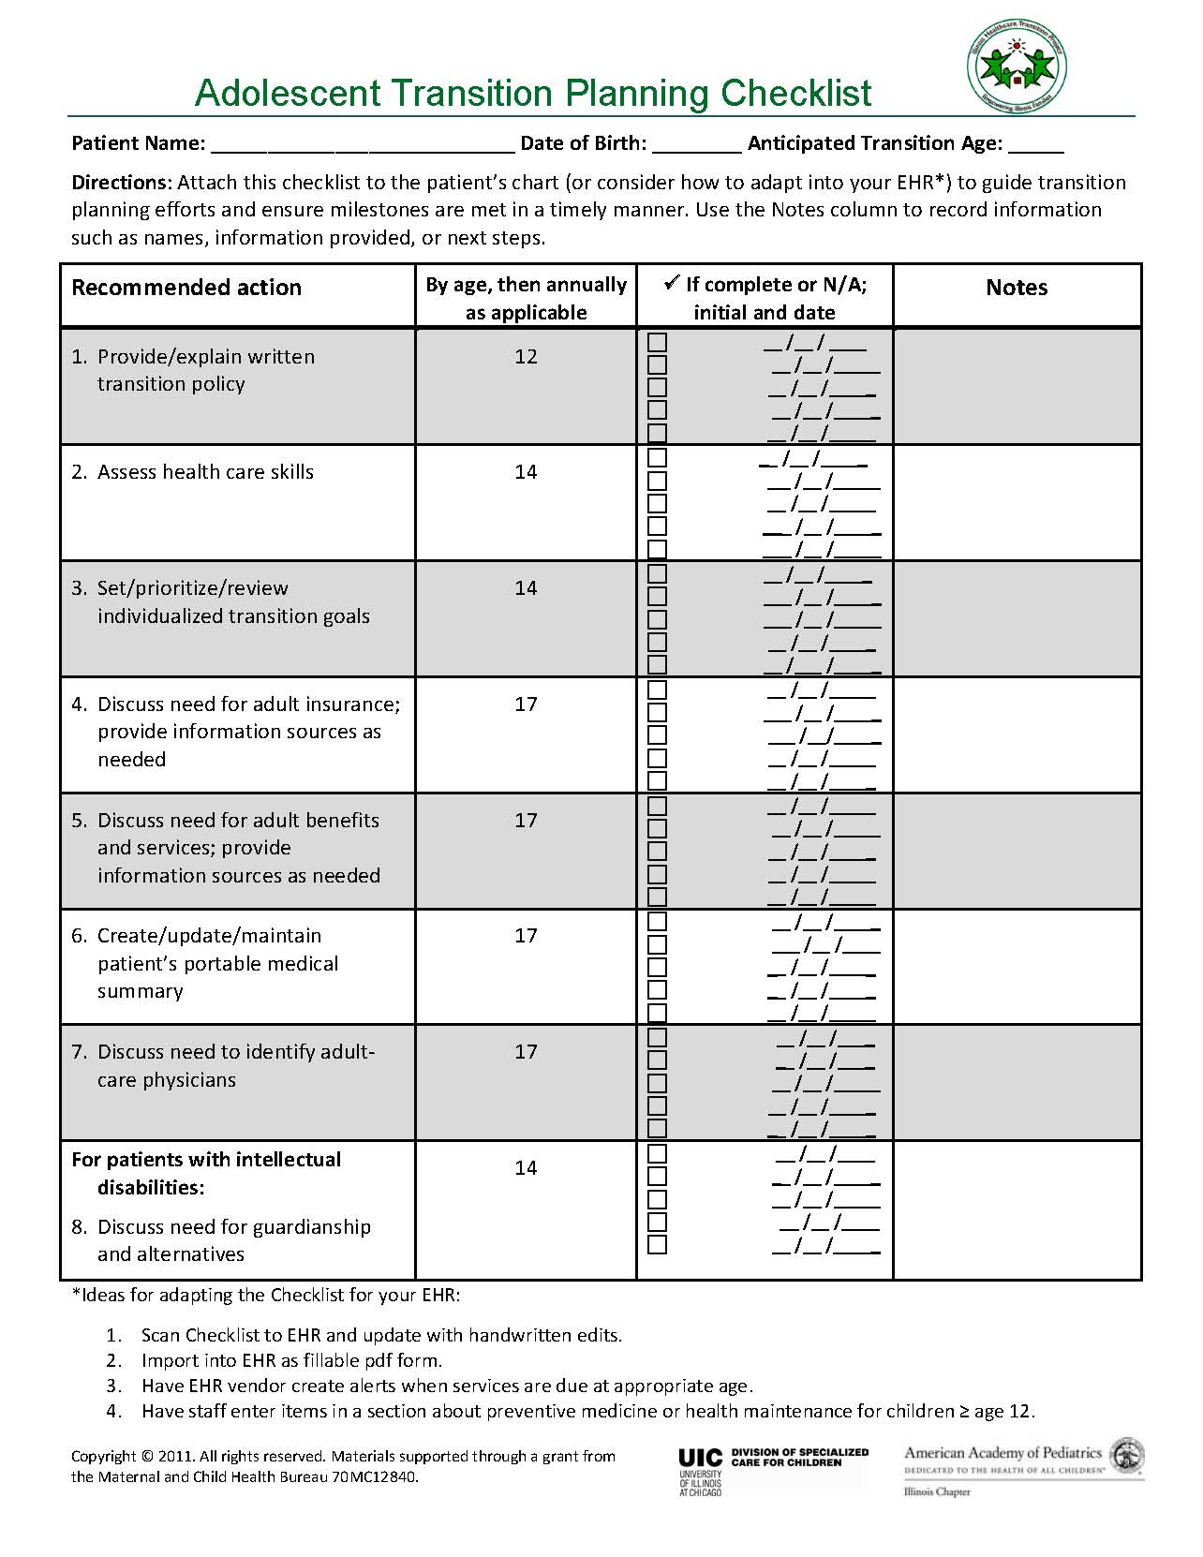

Slide 24
Transition planning over time
Work towards family and patient autonomy goals
Identify “receiving” health care providers
Address other aspects of transition (education, vocation)
Create and update portable medical summary and emergency care plan
Identify medical decision-maker
Document progress in medical record

Slide 25
Transfer of care = Actual transition
“Hand shake not a hand off”
Transfer care to identified adult practice
Send along transfer package (medical summary, emergency care package) to new provider
Self care assessment by new provider
Followed By: Transfer Completion/Ongoing Care
Notes:
Include specific information and tips
What is autism? DME supplier?

Slide 26
Transition strategies and tools

Slide 27
Transition Readiness
Use to assess baseline skills include adaptive self-care skills, navigating health care system and self management of condition
Use to measure progress
Completed by either patient or caregiver
TRAQ
  Validated
  Adapted to 4th grade literacy level in ACP Toolkit
Notes:
TRAQ is a validated, patient-centered questionnaire that providers and families can use to assess youths’ ability to make appointments, to understand their medications and to develop other skills needed for transition to adult care. It is designed to be self-administered and it takes less than 5 minutes for youth to fill it out. The questionnaire can also be filled out by caretakers to get their perspective on their youth’s transition skills. Use of this instrument has the potential to improve transition assessment and support and improve health outcomes during healthcare transition for youth with special health care needs. TRAQ is available in an Excel file to input, score and aggregate results, or in PDF.

Slide 28
http://depts.washington.edu/healthtr/documents/healthcareskills.pdf

Slide 29
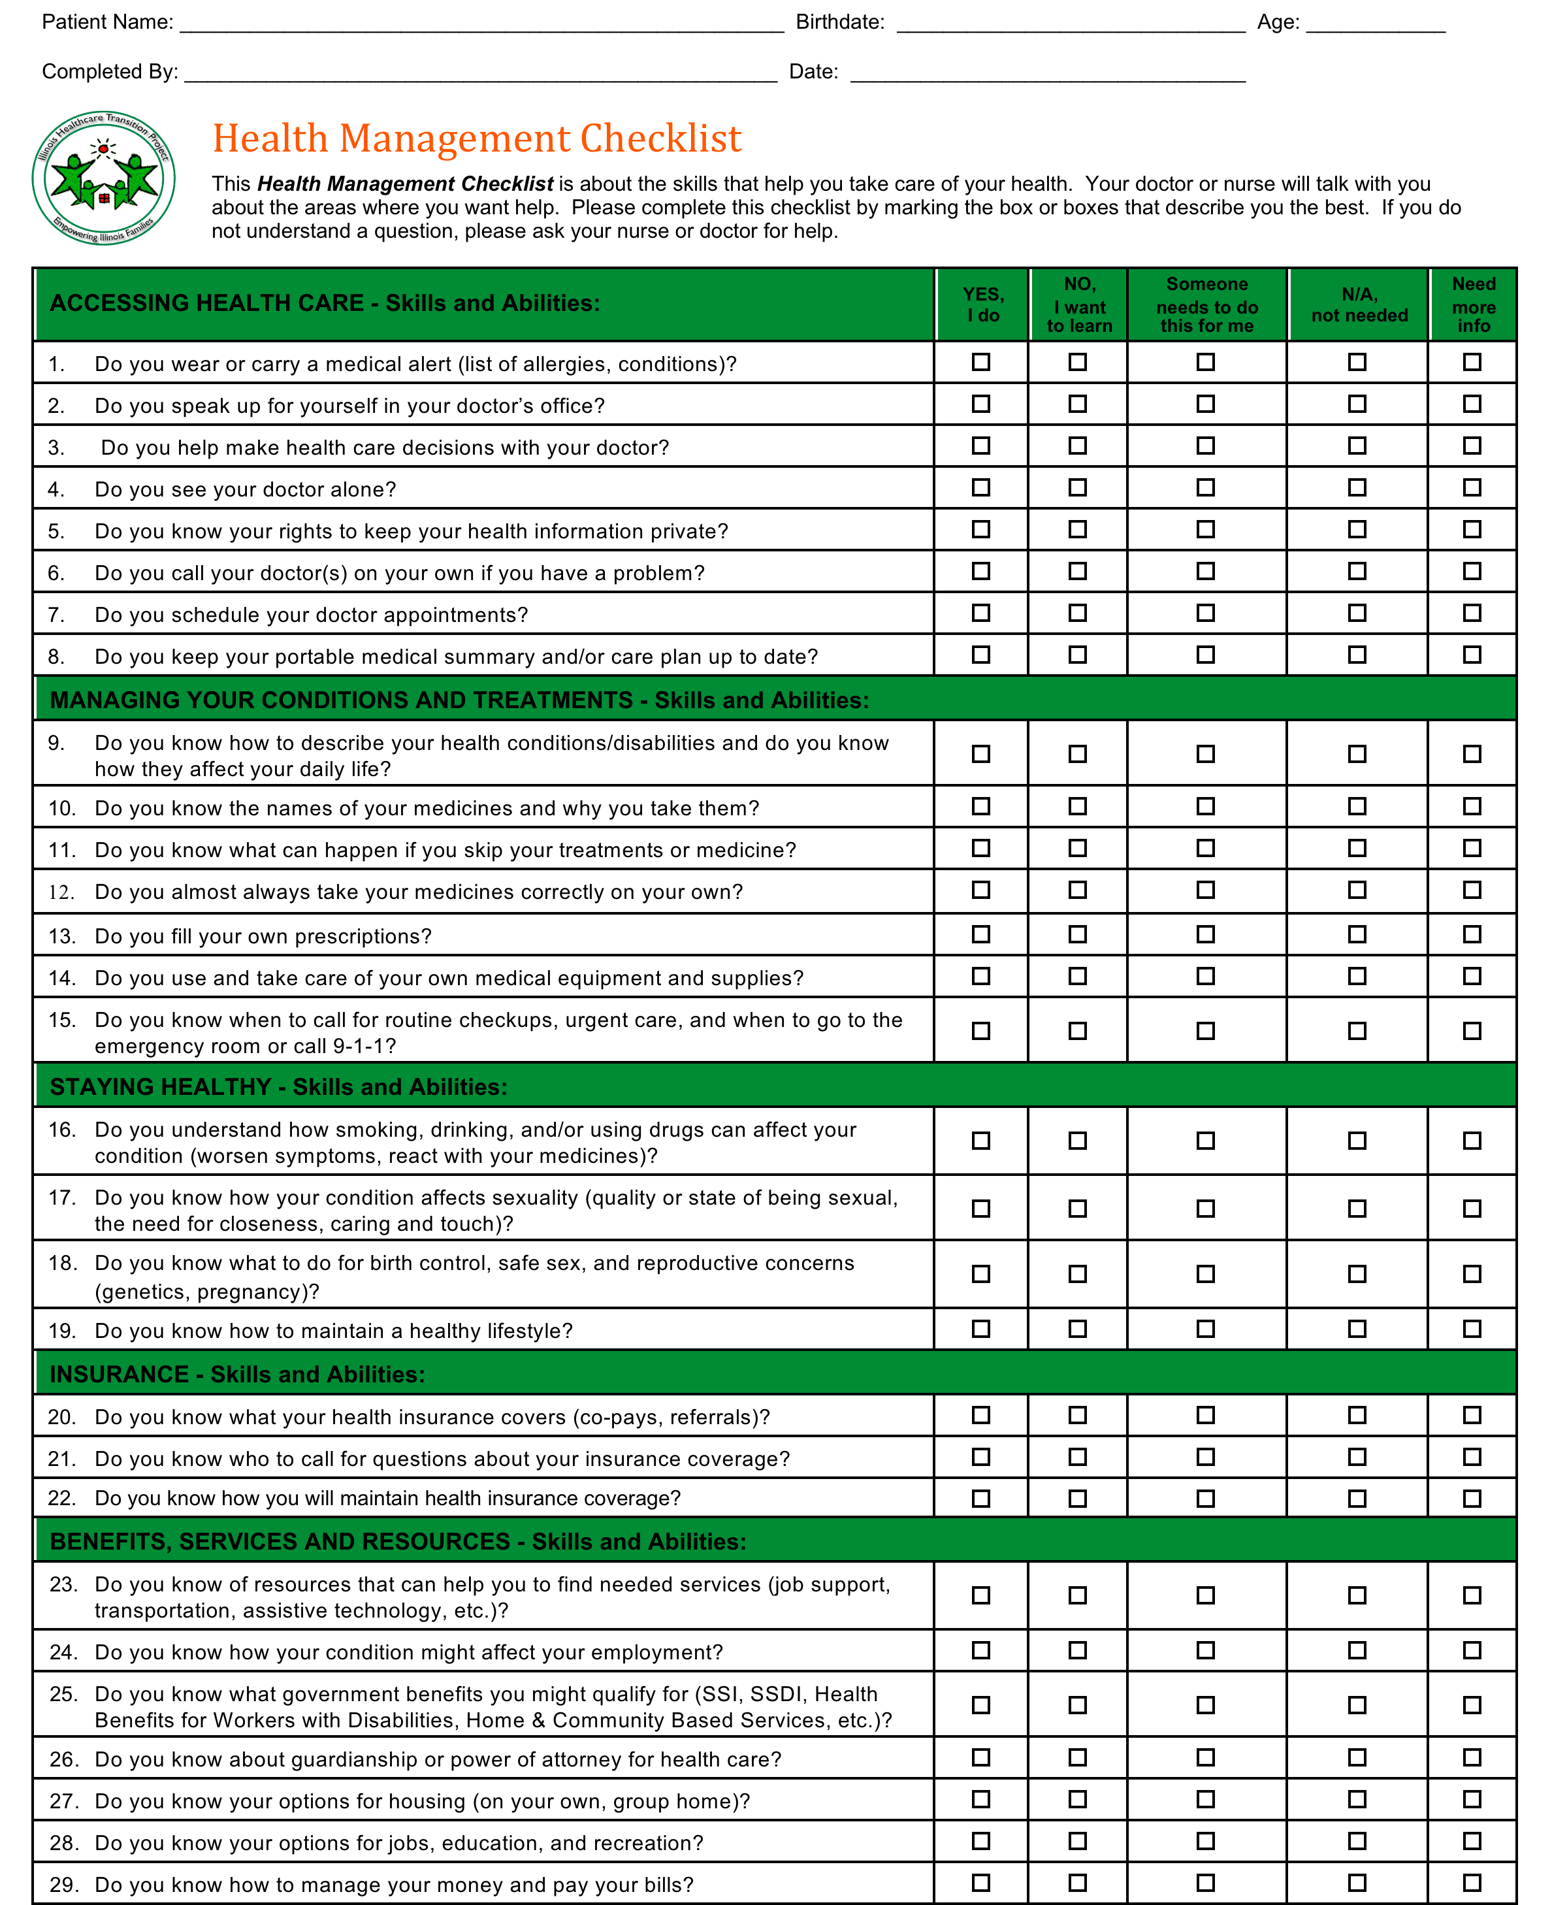
Illinoisaap.org
Notes:
http://illinoisaap.org/projects/transition/
There are many other assessments
Some will include more specific daily care tasks: tooth brushing, nutrition, personal hygiene, fitness, safety
Separate visits to cover these areas more comprehensively can be helpful
Columns give room to ask for help

Slide 30
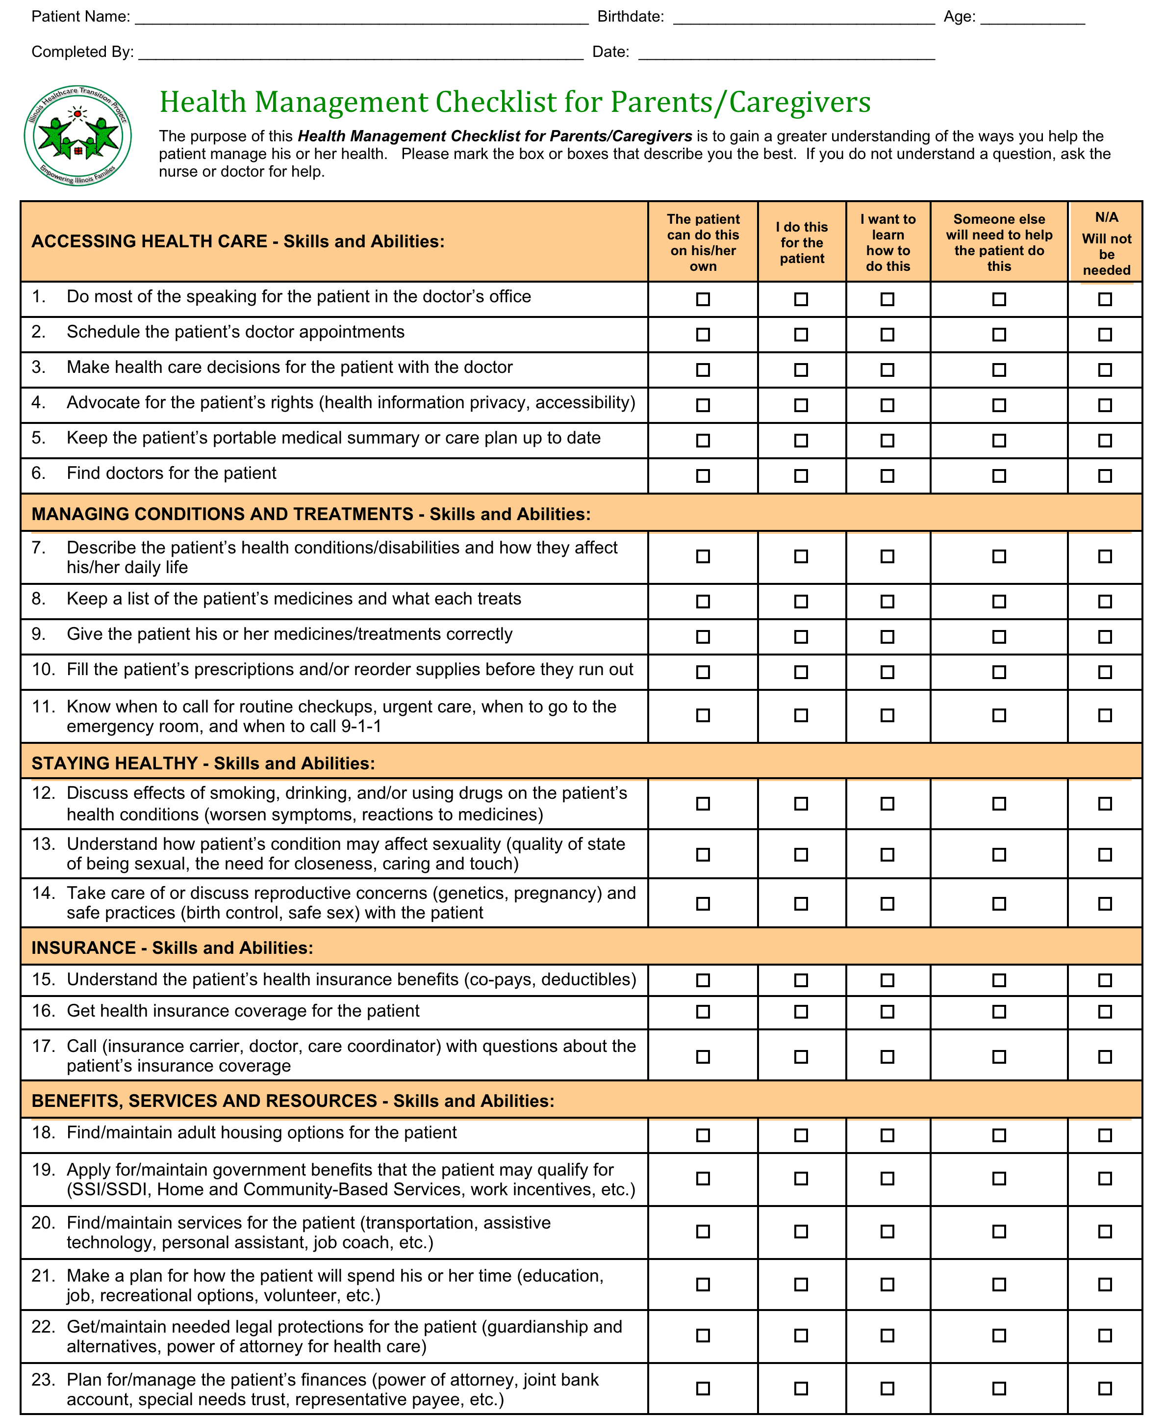
Illinoisaap.org

Slide 31
SMART Transition goals
Specific
Measurable
Achievable
Realistic
Timely
http://illinoisaap.org/projects/transition/
Notes:
Sam will become independent with his daily medication
Sam will learn to use his pill box to organize his medication this month. Mom will teach him.
Sam will take his medication on his own and mark on his chart, so mom can check weekly.
Sam will call the pharmacy for a refill when he has 10 days of medication left, mom will assist as needed.

Slide 32
Skill building
Instruction in practical aspects of navigating health care system
  Making appointments
  Talking with doctor
  Filling prescriptions
  Insurance
Trial or dry runs
Instructional videos
  http://hscj.ufl.edu/jaxhats/Videos.aspx
  http://healthytransitionsny.org/skills/
Notes:
These are important to practice prior to transition to
Website is an interactive online tool
Timeline: http://depts.washington.edu/healthtr/documents/transitiontimeline.pdf
RIC Transition Planning Program (www.lifecenter.ric.org)
Need a prescription for OT and ST group treatment
Beginner 9-13 yo; Young adult 14-22yo
312-238-1139
Access Living (www.accessliving.org): Independent Living Skills Training
Driving assessment
Northshore University Occupational Therapy, Alexian Brothers, RIC, Schwab

Slide 33


Slide 34
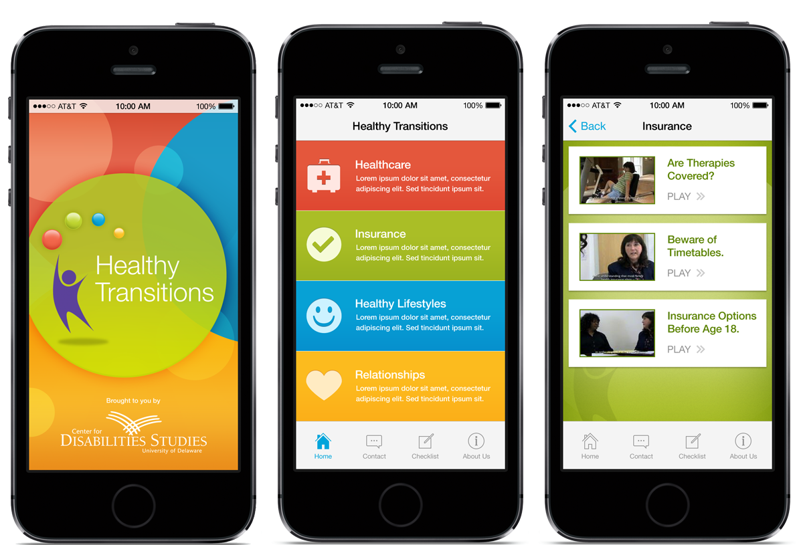
http://www.familyshade.org/agencies/healthy-transitions-mobile-app/
Notes:
Healthy Transitions is a new mobile application designed by the University of Delaware's Center for Disabilities Studies to help young adults with special healthcare needs build skills needed to gain independence and manage their own healthcare. The app features videos that explain how to handle real life scenarios and an interactive game to reinforce the ideas presented in the videos. The videos are categorized into four sections; healthcare, insurance, healthy lifestyles and relationships.
The app is geared toward young adults and uses instructional videos (featuring young adults) to demonstrate basic skills and ideas such as: making a doctor's appointment, scheduling transportation, making healthy food choices, being assertive, understanding health insurance and many others. After viewing the video, the app features a game to support the ideas from the videos. The user collects a digital badge (star) each time he/she views a video and completes the quiz.
The Healthy Transitions app is easy to use and is available for free on iTunes and Google Play. CDS collaborated on the development of the app's content with Healthy Transitions New York, Parent Information Center of Delaware, Delaware Family Voices and Dietary Directions, Inc. Funding came from the Delaware Division of Public Health through a grant from the federal Health Resource and Service Administration. More information is available from Family SHADE at http://www.familyshade.org/agencies/healthy-transitions-mobile-app/ Download the Healthy Transitions App for FREE on iTunes or Google Play: https://play.google.com/store/search?q=healthy%20transition

Slide 35
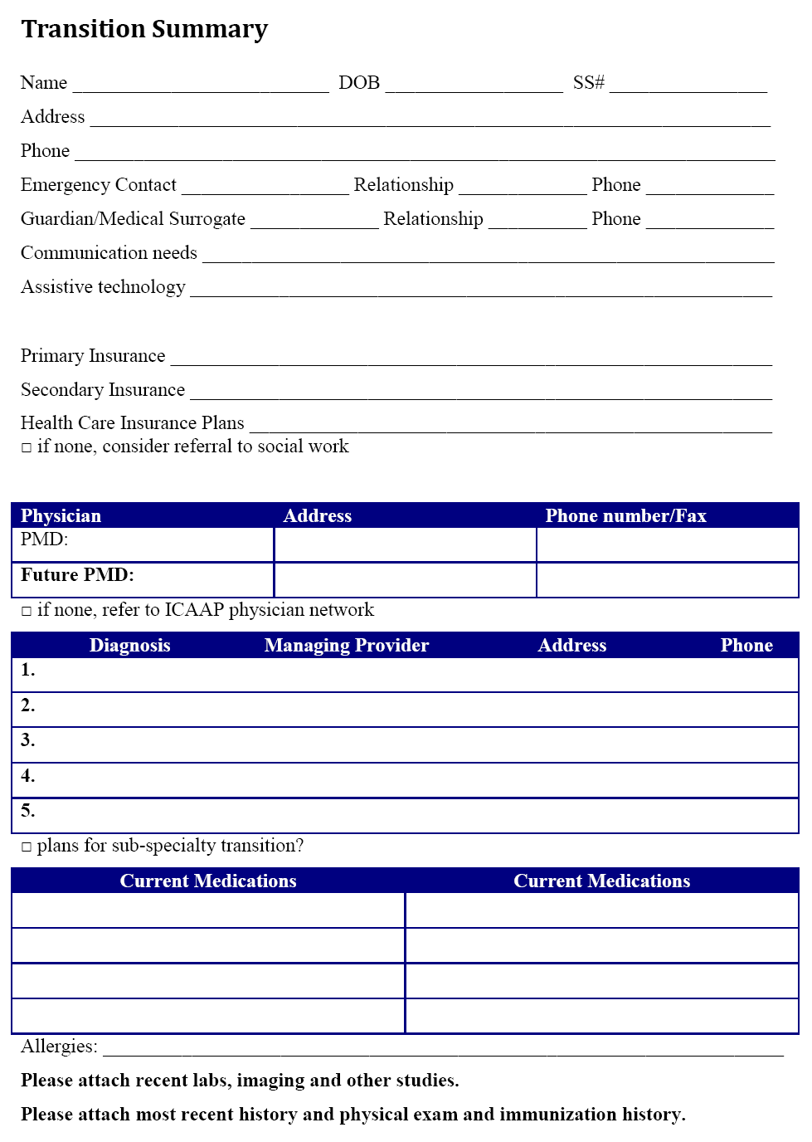
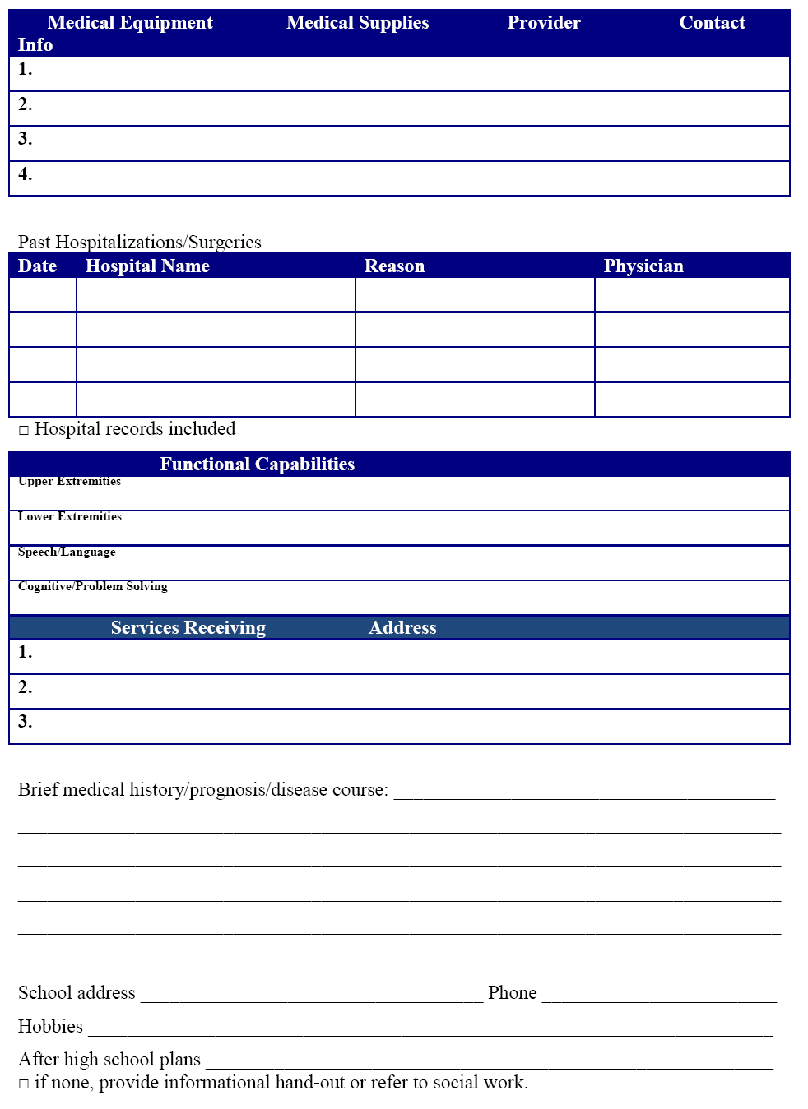
Portable Medical Summary

Slide 36
Portable Medical Summary
Emergency procedures
What works and what doesn’t work
Resources
  In ACP Toolkits
  http://depts.washington.edu/healthtr/documents/hhsummary/hhsummary_eng.pdf
    Available in: English, Chinese, Korean, Russian, Vietnamese, Spanish

Slide 37
ACP Condition-specific guidelines
GIM
I/DD, Physical disabilities
Cardiology
Congenital heart disease
Endocrinology
Type 1 DM, Turner, GH def
GI
IBD
Hematology
SCD, Hemophilia
Nephrology
ESRD
Rheumatology
JIA, SLE
https://www.acponline.org

Slide 38
Condition specific transition guidelines
Autism
Cerebral Palsy
Down Syndrome
Fragile X Syndrome
Diabetes
Available at: http://depts.washington.edu/healthtr/resources/diag.html

Slide 39
Resources
Got Transition
  www.gottransition.org
  Modules available for MOC Part 4 Credit
Florida Health and Transition Services
  www.floridahats.org
National Center on Secondary Education and Transition
  www.youthhood.org
Transition skills
  http://depts.washington.edu/healthtr/documents/tips_teen.pdf

Slide 40
Resources
RIC
  www.lifecenter.ric.org
ICAAP
  http://illinoisaap.org/projects/medical-home/transition/
DSCC
  http://internet.dscc.uic.edu/dsccroot/parents/transition.asp
University of Chicago
  http://transitioncare.uchicago.edu
National Center on Secondary Education and Transition
  www.youthhood.org

Slide 41
Conclusion
Transition is a complex, ongoing process
Start early
Partner with patients, families, providers
Have a well-defined consistent office-based policy
A coordinated transition across all domains is critical for a life-long success for individuals with SHCN

Slide 42
Other aspects of transition?

Slide 43
Guardianship
At age 18, individual legally able to make decisions unless guardianship obtained
Assess adaptive skills and functional level
  Vineland, SIB-R
Identify decision-maker and the limits of decision-making
  Apply at 17 ½
  Different types of guardianship
  Chain of guardianship

Slide 44
What you need from providers?
A supporting letter outlining:
  Nature & type of disability, underlying diagnosis and manifestations, ability to make decisions or function independently
  Analysis and results of evaluations for person’s mental, physical and educational condition
  Opinion if person is totally or partially incapable to making decisions
  Opinion as to appropriate living, treatment and rehab plan

Slide 45
Education
In public school, transition plan should be included in IEP by child’s 14th birthday
  Focus on life skills and community participation
  Include vocational training
  IEP services up to 22nd birthday
Notes:
Through DHS/DRS
To assist an individual with a disability in preparing for, securing, retaining, or regaining an employment outcome that is consistent with the strengths, capabilities, interests, and informed choice of the individual
Respect for individual autonomy
Parallels goal-oriented transition plan

Slide 46
Brittany’s Law
Walking in graduation an important rite of passage
Allows a student with disability to participate in graduation ceremony, but continue to receive secondary transition services through IDEA until age 22
Certificate of completion
Promotes community participation
The Arc of Illinois website; http://www.thearcofil.org/legislative/document.asp?did=426

Slide 47
Vocational Rehabilitation (VR)
Through DHS/DRS
Opening a case part of IEP transition plan
  If not, refer
  https://drs.dhs.state.il.us/owr/setReferral.do
Invite DHS/DRS counselor to IEP meetings
Individual Plan for Employment (IPE)
Notes:
STEP: Secondary Transition Experience Program
Kids with DD need a work history – building work experiences in school as much as possible and building both skills and good work habits

Slide 48
VR Eligibility Determination
1.General eligibility determined by Certified DRS-VR Counselor:
Is the individual a person with a disability?
Does the individual require VR services?
Can the individual benefit from VR services?
2. Order of selection
Based on functional limitations- individuals with most significant disabilities served first

Slide 49
Education and Vocational Resources
The Illinois State Board of Education : Educational Rights and Responsibilities: Understanding Special Education in Illinois.
  www.isbe.net
Family Manual on Transition to Employment and Adult Services for Youth with Developmental Disabilities in Illinois.
  http://www.familyvoicesillinois.org/documents/documentdetails.asp?did=2486
  Special Education Clinic/Helpline
    (866) KIDS-046
    specialed@equipforequality.org

Slide 50
Education and Vocational Resources
The Illinois State Board of Education : Educational Rights and Responsibilities: Understanding Special Education in Illinois.
  www.isbe.net
Family Manual on Transition to Employment and Adult Services for Youth with Developmental Disabilities in Illinois.
  http://www.familyvoicesillinois.org/documents/documentdetails.asp?did=2486
  Special Education Clinic/Helpline
    (866) KIDS-046
    specialed@equipforequality.org

Slide 51
Skill building/Community participation
RIC Transition Planning Program www.lifecenter.ric.org
    Need a prescription for OT and ST group treatment
    Beginner 9-13 yo; Young adult 14-22yo
    312-238-1139
Access Living www.accessliving.org
    Independent Living Skills Training
Driving assessment
  Northshore University Occupational Therapy, Alexian Brothers, RIC, Schwab

Slide 52
PUNS: Prioritization of Urgency of Needs of Services
Through Illinois Department of Human Services
List of everyone in IL with DD who may need services now or in future
Examples of services offered: Residential living, Job coaches, Respite, Adaptive equipment, Other supports to improve QOL
Register as teen
Need an interview with coordination agency
Receiving services not a guarantee
1-888-DDPLANS; http://www.dhs.state.il.us

Slide 53
Advocacy
Families Resources Center on Disabilities
  www.frcd.org
Equip for Equality
  www.equipforequality.org
  Protection and Advocacy (P & A) Program
  Federally funded

